Slide 2
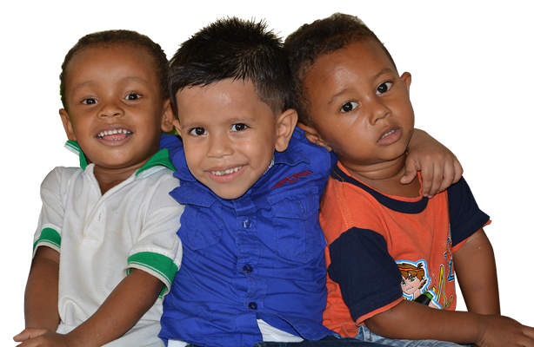
Who are we?
A non-profit, non-governmental organization, with more than 20 years of experience, we responsibly manage public and private resources to care for children and children in vulnerable areas.
We know the social problems of our region in depth and we execute nutritional, psychological and pedagogical programs for the benefit of children.
We care about positively impacting the families that benefit from the different programs that we execute throughout the Colombian territory.

Slide 3
Our Values
Dignity
At FUNDESOE, this value leads us to be responsible towards all representations of life, we work daily so that our Colombian boys and girls can live and develop with quality.
Education as a solution
At Fundesoe we are convinced that education is the solution to many of our society's problems, which is why we are dedicated to the quality of education we offer children, their families and our employees.
Social growth
FUNDESOE wants to leave a mark on this society, our passion to grow leads us to look for opportunities every day that allow us to maintain and expand our activities, in order to help more and more families.

Slide 4
Managed Resources
During all these years we have achieved an efficient and responsible management of the resources received by public and private entities. Every year we report our management with total transparency and legality before the DIAN (Directorate of National Taxes and Customs).
Income declared in the last 5 years:
2017 $8.235.231.000 COP - $2.669.442 EUR
2018 $8.027.669.000 COP - $2.284.481 EUR
2019 $8.838.098.000 COP - $2.488.203 EUR
2020 $1.522.098.000 COP - $401.608 EUR
2021 $34.827.118.000 COP - $8.043.214 EUR
TOTAL $61.450.213.999 COP - $14.191.735 EUR
* The calculation in Euros was made with the average price during the month of January of the respective year.

Slide 5
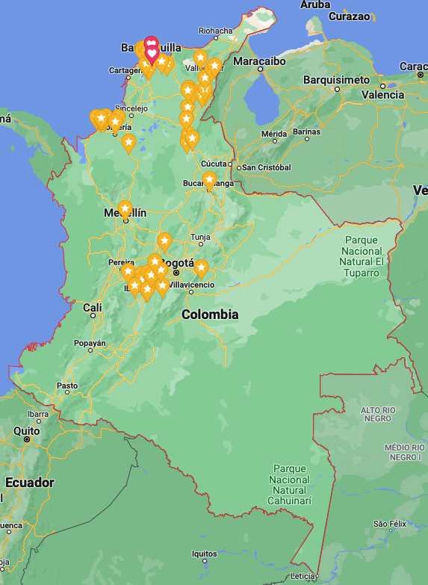
Our history
FUNDESOE has a great professional team that for years has stood out for its great commitment to ensuring the resources received without compromising the quality of the service or products delivered.
We achieved a positive impact on more than 80,000 families in more than 100 municipalities nationwide.
Deliverables :
Food
School Kits
Institutional Uniforms
Kids’ uniforms
Accompaniment in parenting guidelines, nutrition, psychology and comprehensive education (children and family members).
YEAR | CHILDREN
2010 | 899
2011 | 899
2012 | 899
2013 | 1.237
2014 | 1.237
2015 | 1.156
2016 | 25.454
2017 | 16.451
2018 | 4.505
2019 | 3.260
2020 | 390
2021 | 13.205
2022 | 13.205
TOTAL | 82.797

Slide 6
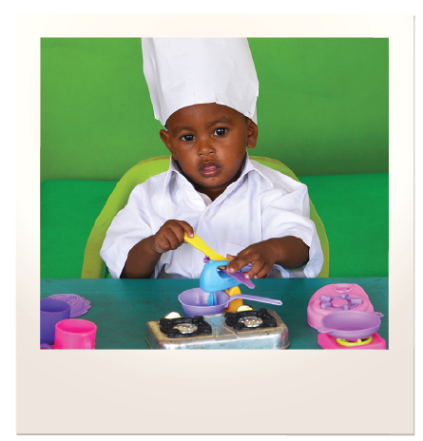
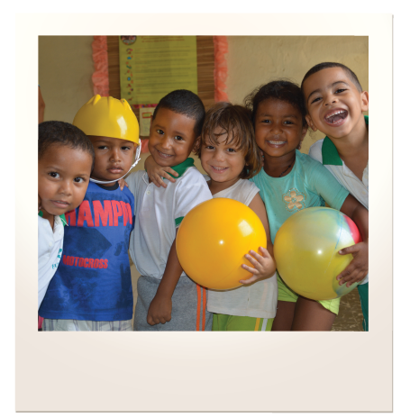
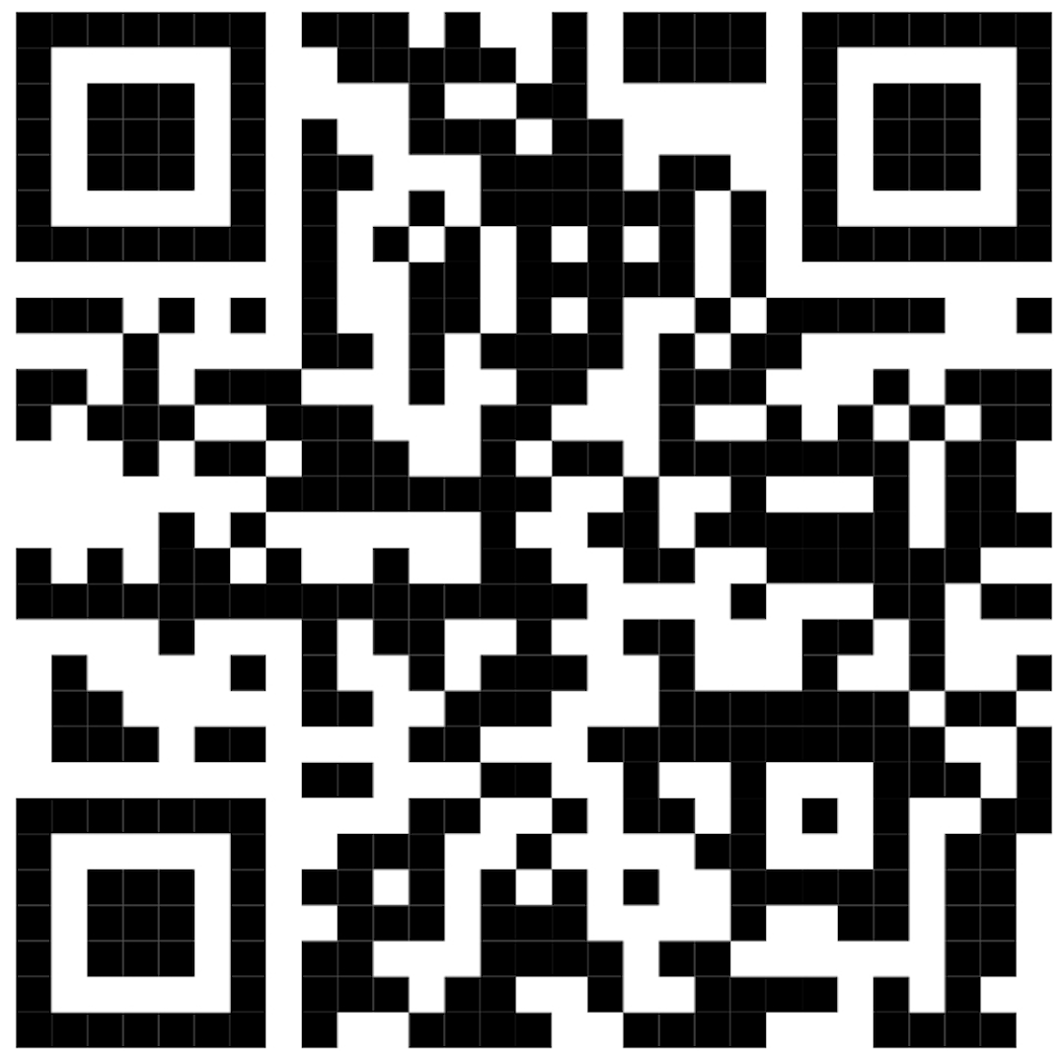
Contact info
Fundación para el Fomento de la Democracia, el Desarrollo Social y la Ecología - FUNDESOE
NIT 800.205.721-5
www.fundesoe.org
Calle 68 # 61 – 59 Barrio Bellavista ZIP 080002
Barranquilla, Colombia
+57 310 4764442 / +57 313 3890242
info@fundesoe.org
DONATIONS
Bank: Davivienda
Barranquilla, Colombia
Swift code: Cafecobb
Checking account:
No. 026169995607
Bank’s address: Carrera 54 70 189
Bank’s pone No.: +57 1 3300000
3Bp7rAJnmos2tXTb1pDEgDyW4bqQm9fihi

